Slide 1
Images of Aging Project
Trevor Barrow, Yutong Liu

Slide 2


Our Team
Mark Borgschulte, Professor of Economics
The UC Berkeley Team

Slide 3
CEOs
+
Politicians
Do they age faster?
Notes:
To determine if Fortune 500 CEOs and US politicians over the past 100 years age at a different rate than the average person, and if so, to determine what said rate would be.

Slide 4
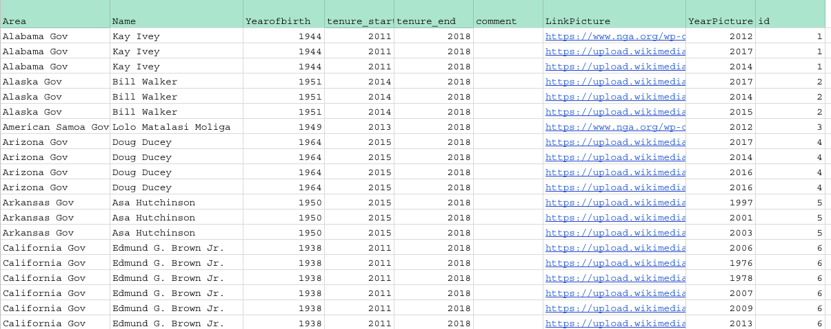
1. Collect Photos

Slide 5
3234
Photos collected
Notes:
We have collected 3234 photos in total over the entire semester.
This provides a strong foundation for our data analysis.

Slide 6


2. Python code
3. Calculate
-> Facial recognition software
-> Age estimations
Notes:
2. Put those through Python code to produce age estimations from facial recognition software built by amazon and microsoft. (thank you so much for allowing us to use your product to analyse you XD)
3. Calculate the necessary measurements (mean squared error, standard deviation, average error etc) using Excel for analyzing the data.

Slide 7
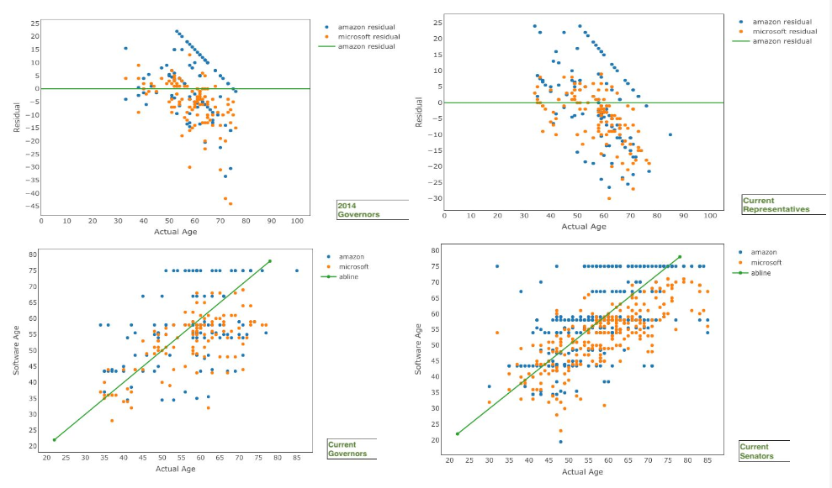
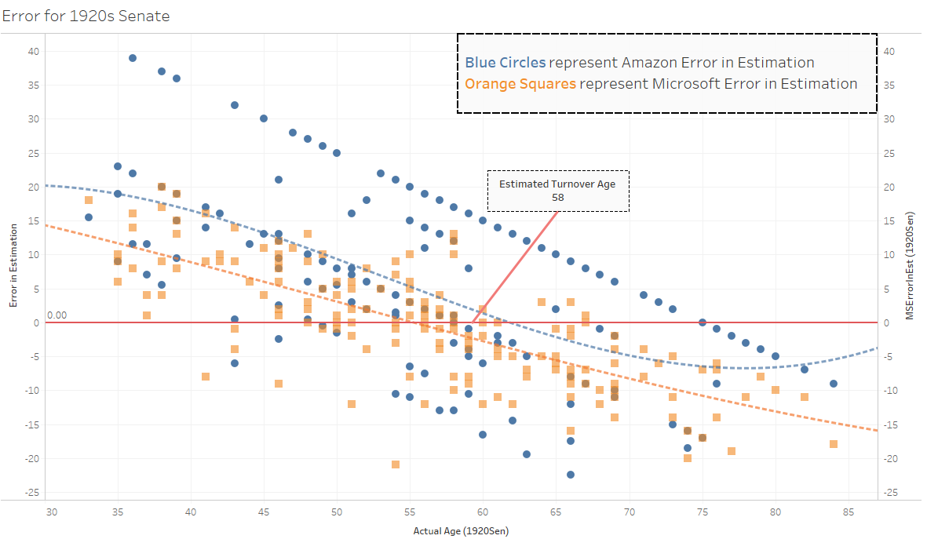
4. Data visualization
Notes:
Use data visualization programs (R, Python, Tableau) to make sense of everything.

Slide 8
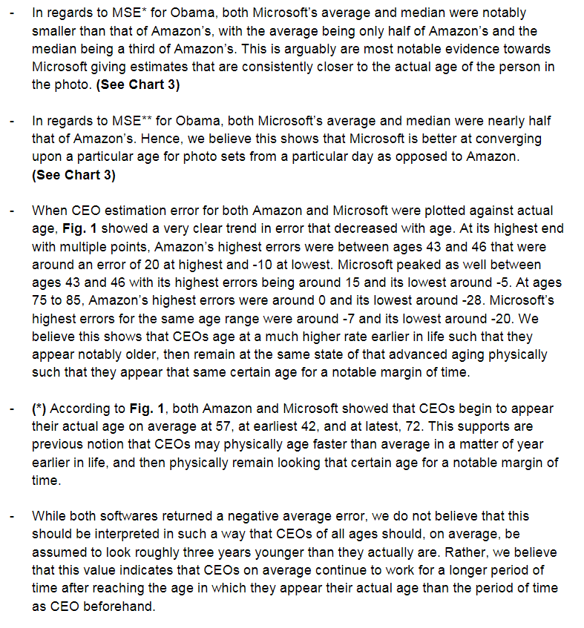
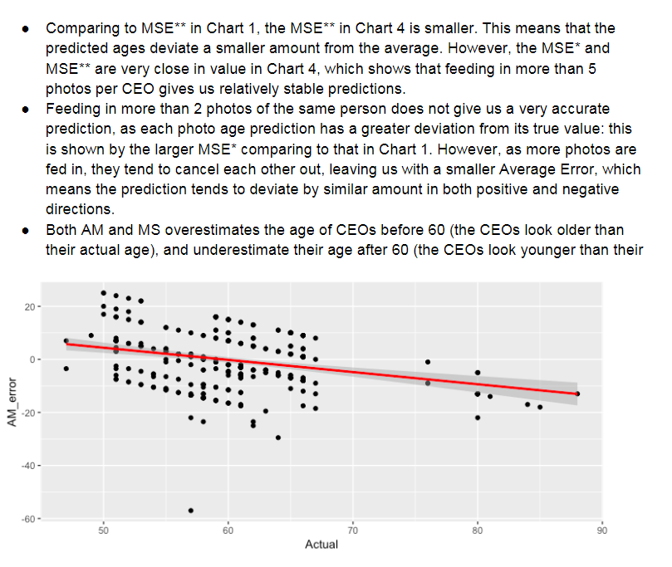
5. Analyze
Notes:
5. Analyze the visualized data for trends and determine their significance.

Slide 9
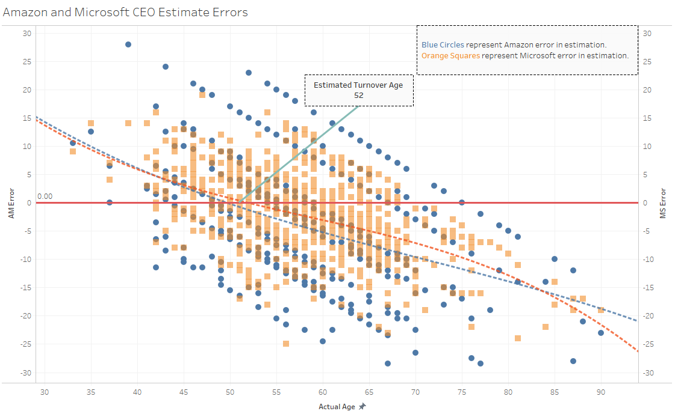
CEOs:
Actual Age
vs.
Error

Slide 10
52
CEOs start appearing younger at age
Notes:
Fortune 500 CEOs seemingly physically age at a higher rate earlier on in life such that they appear older than they really are, and then remain looking that physical age for an extended period of time.
This period remains long enough that they eventually pass a point we refer to as the ‘Turnover point,’ in which they go from looking older to younger. Here it is 52.
They then seemingly appear younger for the rest of their career after this point.

Slide 11
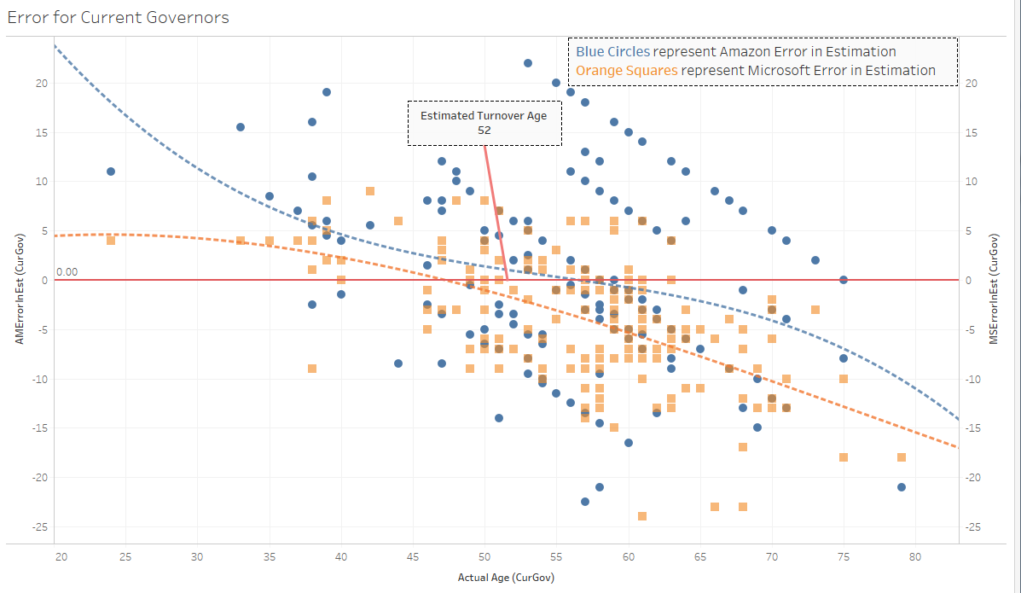
Current Governors:
Actual Age
vs.
Error

Slide 12
Politician Rates of Aging
US politicians seemingly physically age at a rate higher rate earlier on in life.
Appear younger after, similar to CEOs.
Reach a turnover point.

Slide 13
54
52
49
Representatives
Governors
Senators
Notes:
However, they seemingly reach a turnover point earlier on in life the higher up they are in the government.
Representatives at 54.

Slide 14
60
Senators from ‘20s, ‘40s, and ‘60s
Notes:
Senators from ‘20s, ‘40s, and ‘60s have a much higher turnover point at 60.

Slide 15
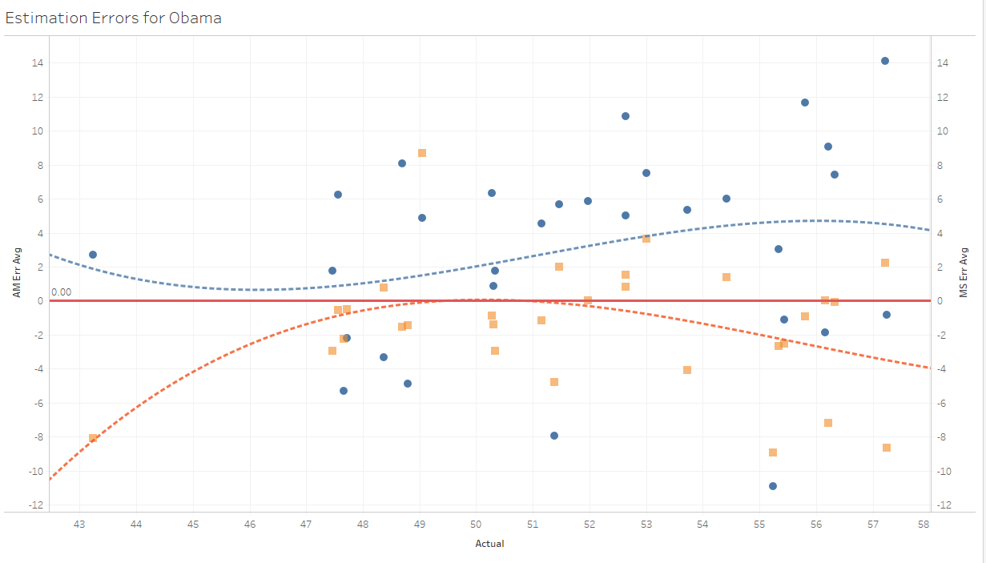
Obama:
Actual Age
vs.
Error

Slide 16
Obama’s Rate of Aging
Appeared up to three years younger before presidency.
Appeared older such that he appeared actual age at 48, one year into first term.
By end of presidency, consistently appeared between two and five years older than he actually was.
In current photos, he has continued to look older than he actually is.
Has yet to reach a turnover point.

Slide 17

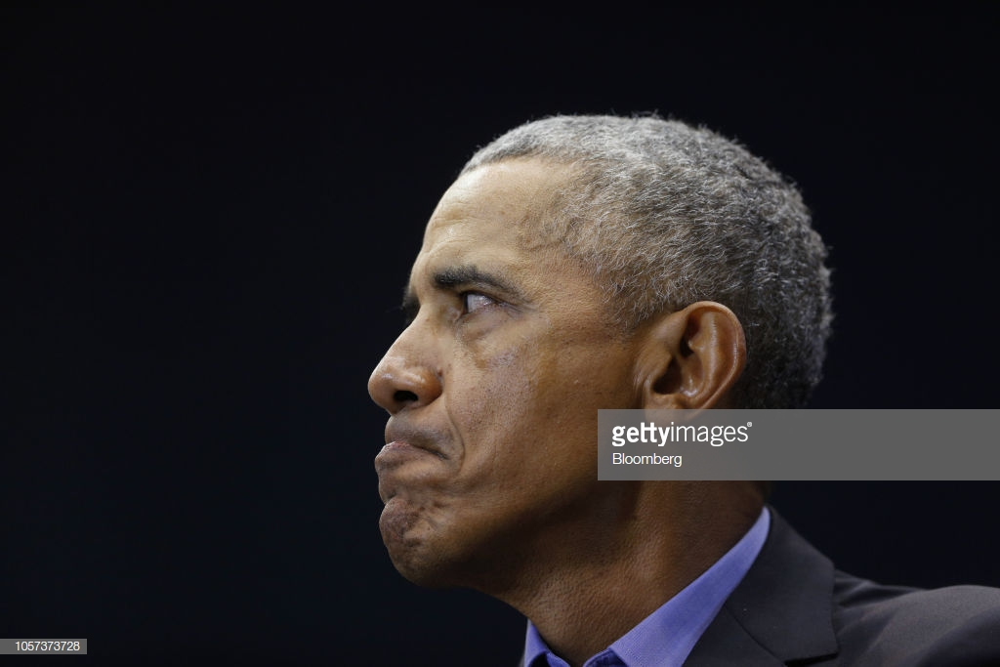
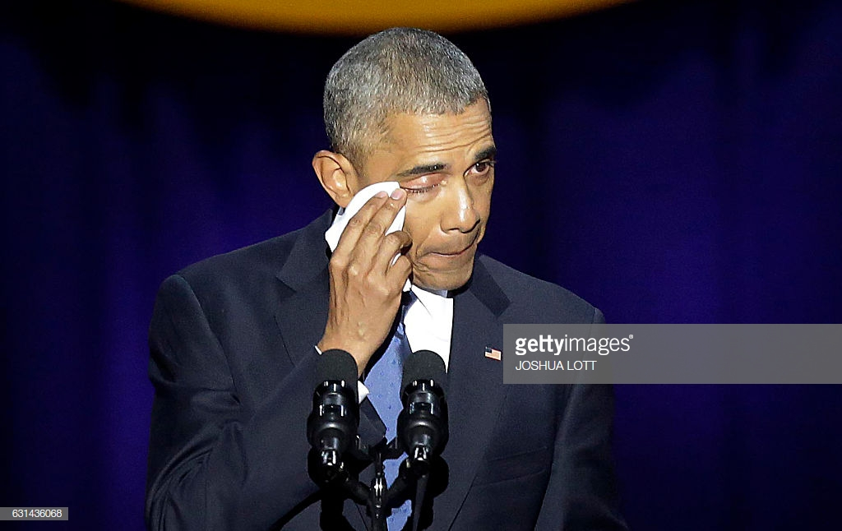
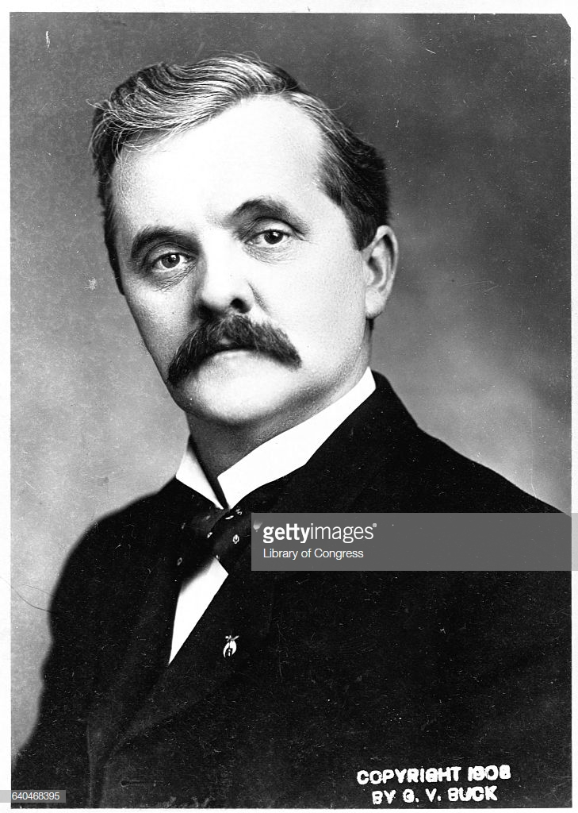
Additional Discoveries
Improper lighting can cause someone to look up to twenty years older or younger than they actually are.
15 photos for a single person returns the most ideal results as it produces the smallest average error.
A person’s head being turned / eyes closed has more bearing on error in age estimation than any other factor.
Notes:
Sources of improper lighting:
Shadow of nearby objects
Lighting (e.g. glasses)
10~15 photos for each individual would give the closest age prediction overall for both amazon and microsoft
We all had experiences of bad photos:
either your eyes closed
Or maybe just one eye closed??
Or your head is turning to the other direction

Slide 18
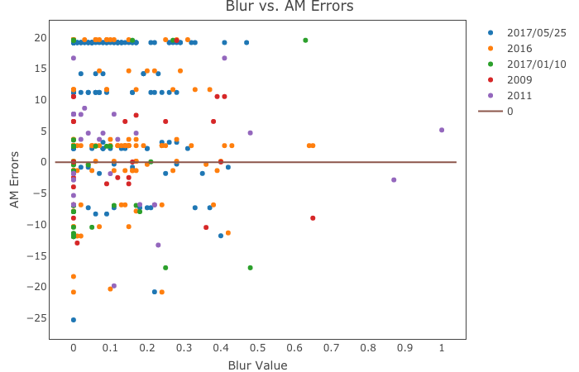
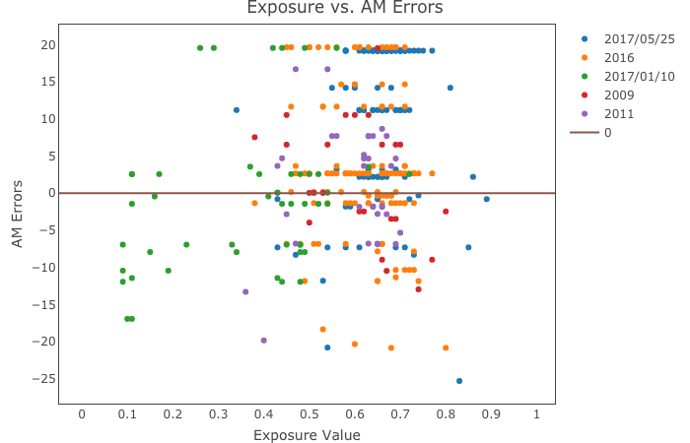
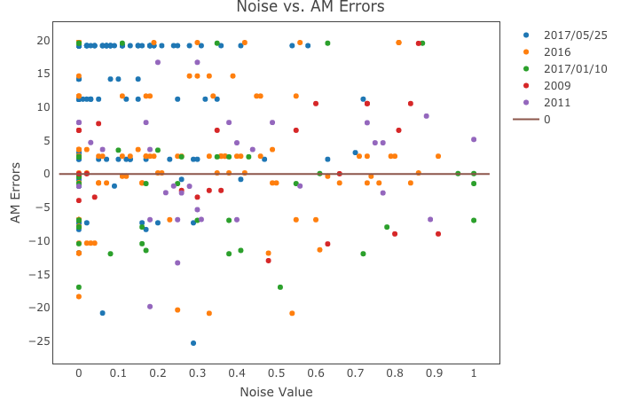
Noise | Exposure | Blur
Do they matter?
Notes:
Now it comes down to the picture quality:
Do they matter? We can see this from the graph: the answer is no, they don’t

Slide 19
Goals We’ve Achieved
Strengthened communication and coordination between team members.
Gathered large enough dated photo collections such that sample size was not an issue in accuracy of our results.
Efficiency in analyzing large datasets and the statistical measurements we calculate from them (R-squared, Mean Squared Error, etc.)
Proficiency in visualizing large datasets via R and Tableau.
Adeptness in communicating technical research to a non-technical audience.

Slide 20
Challenges We’ve Faced
Time necessary to collect sufficiently large
sets of dated photos from various time periods.
Basic experience with R and Python.
No prior experience with Tableau.

Slide 21

Thanks!

